Slide 1

Phase 3 Code Demo
Team 2 Group 5
Training and Recruitment
Notes:
1

Slide 2



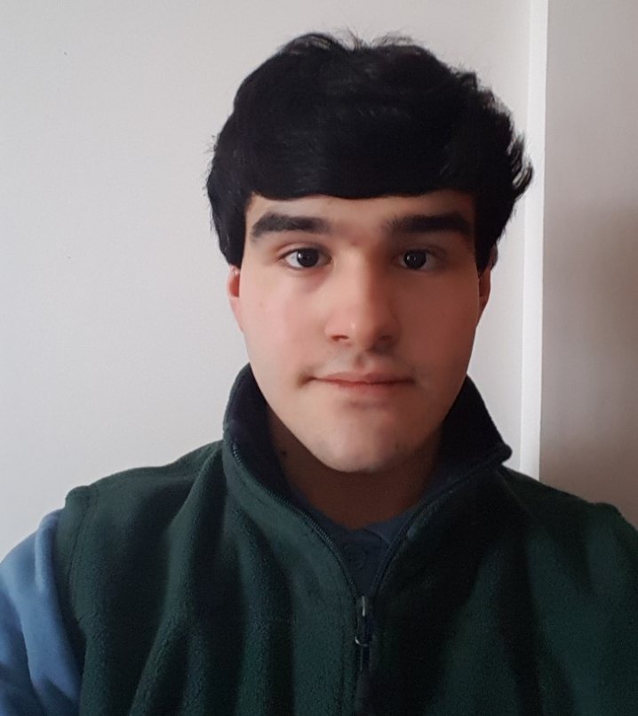
Team
Syed Zaki Zaidi
Kerri-Anne O’Brien
Hossam Farfour
Saleh Mohamed
Luke Waddington
SEMINAR HEAD
Project Manager
Documentation LEAD
RESEARCH LEAD
30010702
30014123
30008722
30001162
2
Notes:
2

Slide 3



Agenda
Zaki
Topic one
Topic two
Topic three
Topic four
Topic five
3

Slide 4

UML
4
Notes:
4

Slide 5
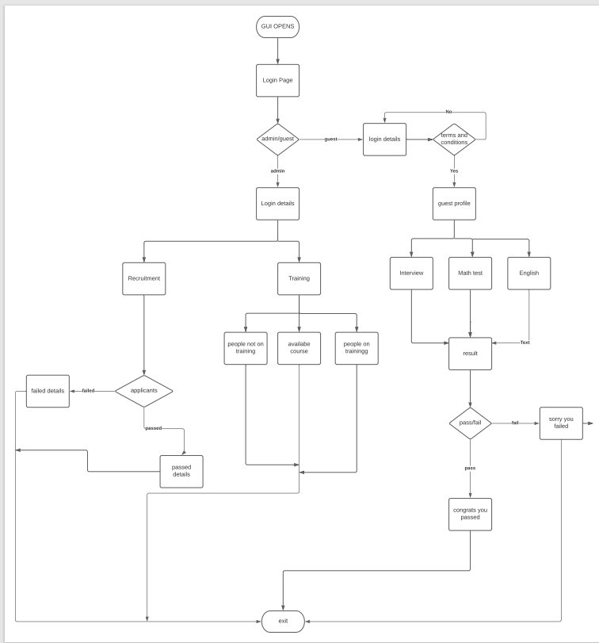
UML
Saleh
Text
5
Notes:
5

Slide 6
Code
6
Notes:
6

Slide 7
Code Demo
Zaki
Video:
Text maybe
1- talk about the current code
2- talk about the things we are going to add
Try adding database thingie int0 it
3- talk about lespi in the video
7
Notes:
7

Slide 8
Testing
8
Notes:
8

Slide 9
Testing
Kerri-Anne
We covered:
Two screen shots of testing. Change Approve to pass and in progress to fail.
Screen Layout on start up
Admin button
Admin Entry
Guest button
Guest Entry
Registration button
Registration Entry
Registration details saved to text file
9
Notes:
Testing was done by all team members. We recorded all tests in a table detailing the type of test carried out. Explain acceptance. A description explaining what the test covered. A explain ad to that is expected from the test. A explanation of what the test actually reviled. Any commend on the test outcome. The status of the outcome whether it was approve, in process or denied -> search and explain. Who the text was done by the date of the test and the name of the screen shot that is evidence of the test being carried out. The image below is the testing of the admin login.
9

Slide 10
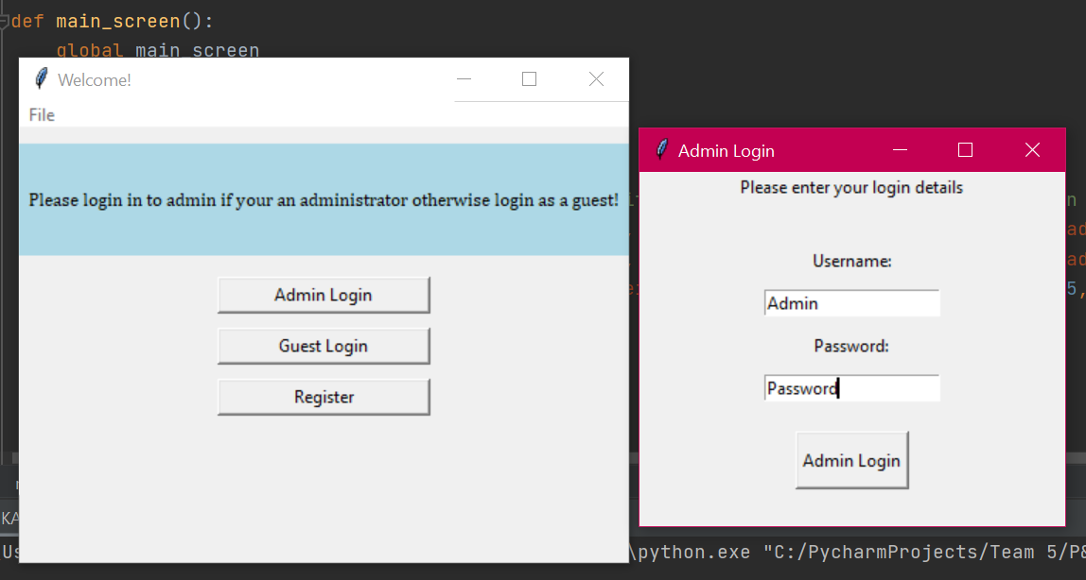
Explain all of the tests

Slide 11
Report
11
Notes:
11

Slide 12
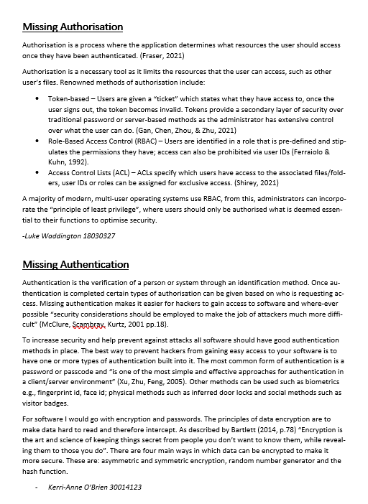
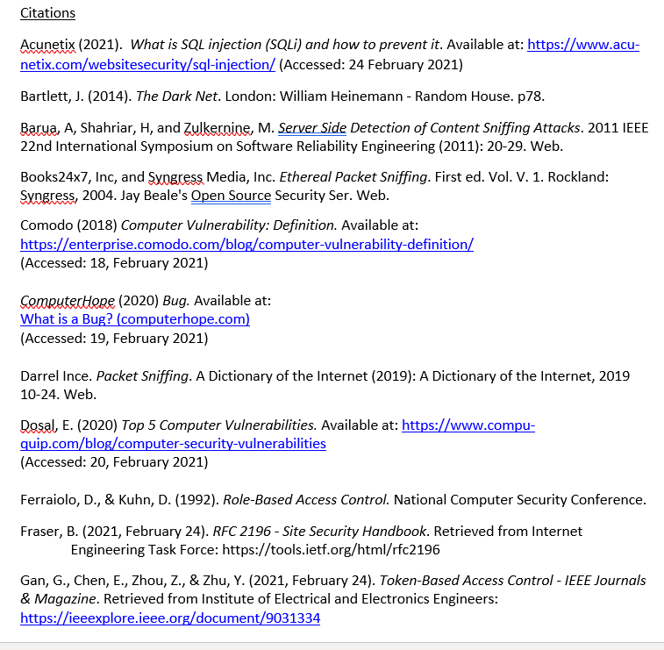
Report
Luke
We Covered:
Password Vulnerabilities
SQL injection
Buffer Overflow
Bugs
Missing Authorisation
Missing Authentication
Sniffing
12
Notes:
The vulnerability report was done by all team members. Harvard style refencing
12

Slide 13
Communication
13
Notes:
13

Slide 14
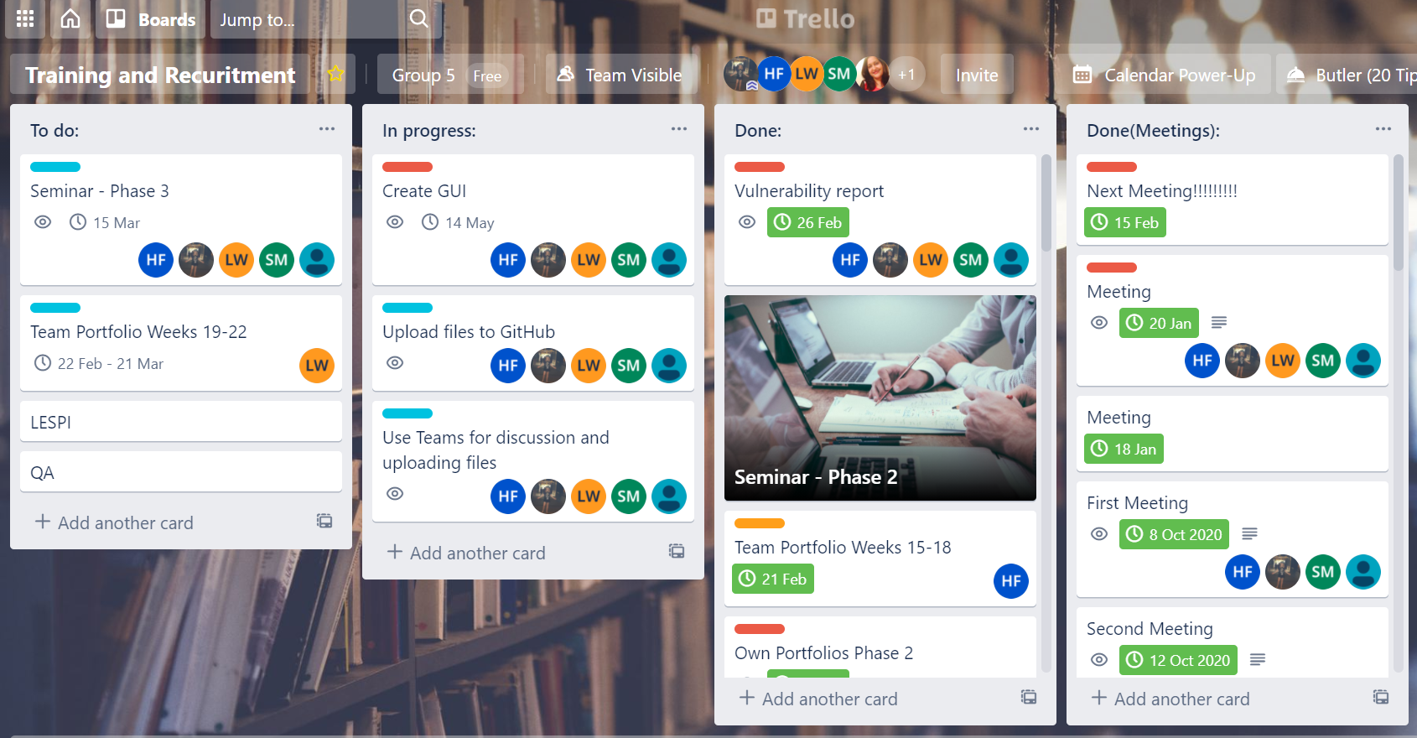
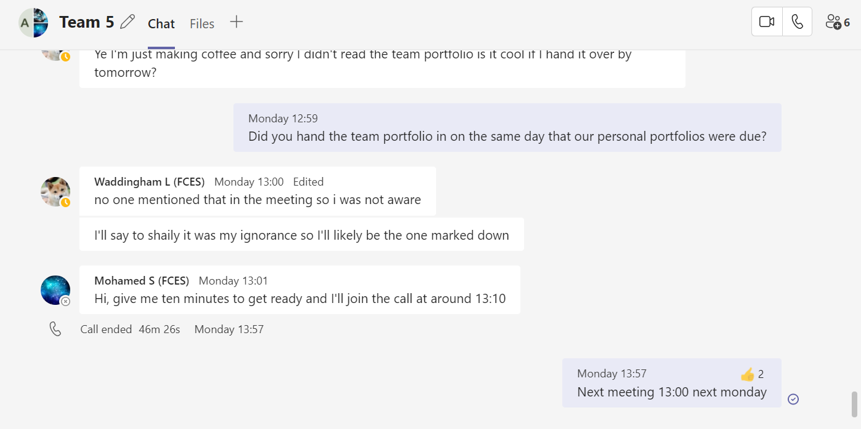
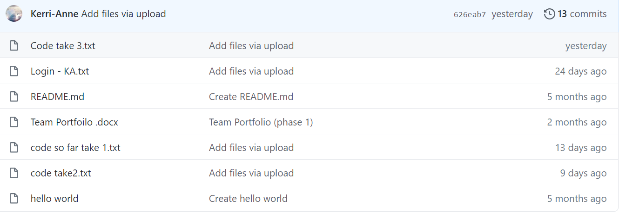
Communication
We communicated through:
Trello
GitHub
Teams
Hossam
14
Notes:
14

Slide 15

Summary
With PowerPoint, you can create presentations and share your work with others, wherever they are. Type the text you want here to get started. You can also add images, art, and videos on this template. Save to OneDrive and access your presentations from your computer, tablet, or phone.
15
Notes:
15

Slide 16


Thank You for listening
16

